Slide 1
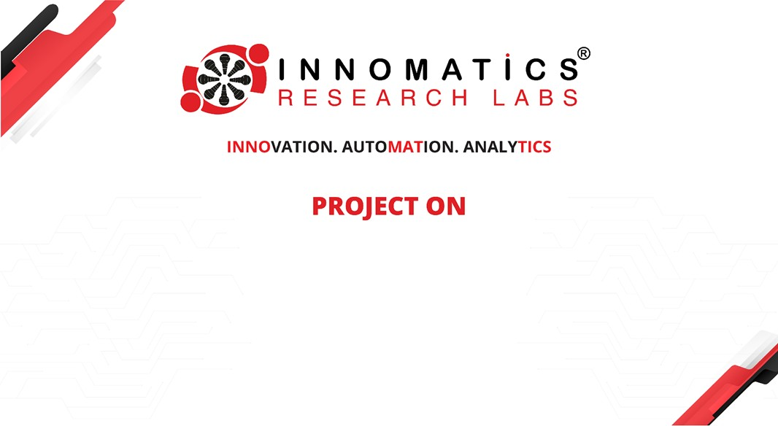
Exploratory Data Analysis on AMCAT Dataset
Venkatasai Singamsetty

Slide 2


About me
I am passionate about optimizing online customer experiences through data-driven insights. I hold a Bachelor’s in Commerce with Computer Applications from Osmania University and recently completed my MCA with a grade of 7.12, focusing on machine learning and AI. At Cognizant, I began as a Data Programmer Trainee, where I analyzed data for accuracy and adherence to industry standards. Now, as a Quality Analyst, I monitor customer behavior and implement strategies to enhance website performance. My experience as a Fullstack Development Trainee at NxtWave has further strengthened my skills in web application development and testing. Committed to continuous learning, I actively participate in hackathons and tech meetups to stay updated with industry trends. I’m eager to leverage my skills to drive meaningful improvements in data analysis and online customer experiences.
https://www.linkedin.com/in/venkatasai-singamsetty/
https://github.com/sai7658

Slide 3
Agenda
Business Problem and Use case domain understanding(If Required)
Objective of the Project
Web Scraping – Details (Websites, Processor you followed)
Summary of the Data
Exploratory Data Analysis:
Data Cleaning Steps
Data Manipulation Steps
Univariate Analysis Steps
Bivariate Analysis Steps
Key Business Question
Conclusion (Key finding overall)
Q&A Slide
Your Experience/Challenges working on Web Scraping – Data Analysis Project.

Slide 4
The primary goal is to analyze the employment outcomes of engineering graduates, specifically focusing on salaries, job titles, and job locations. This analysis aims to identify key factors influencing these outcomes.
Business Problem and Use case domain understanding:-
Objective of the Project
The objective is to analyze job market trends and optimize recruitment strategies based on data extracted from job postings and candidate profiles.
Goal: To scrape data on job postings and candidate qualifications from various job portals, analyze trends in employment, and provide actionable insights for improving recruitment strategies.
Summary of the Data
The provided dataset contains information on employee details, including gender, age, specialization, college details, salary, designation, and location.
It allows for an in-depth understanding of the current workforce in terms of demographics, skills, and career paths.

Slide 5
Exploratory Data Analysis:
EDA involved analyzing the distribution of variables like gender, specialization, age, and salary to understand the overall characteristics of the workforce.
We explored the relationship between variables like college GPA and salary to identify potential correlations and drivers of compensation.
Data Cleaning Steps
Handling Missing Values: We checked and handled missing values, ensuring a complete dataset for analysis.
Data Type Conversion: Converted variables like gender and date of birth to appropriate data types for analysis and visualization.
Removing Redundant Information: Removed irrelevant or duplicate columns to simplify the dataset.

Slide 6
Data Manipulation Steps
Derived New Variables: Created new features like employee tenure and age based on existing data.
Grouped Data: Grouped data based on features like gender, specialization, and designation to enable comparative analysis.
Reshaped and Pivoted Data: Reshaped the dataset in different ways for visualization and better presentation of findings.
Univariate Analysis Steps
Performed visualizations to understand the distribution of individual features (e.g., gender, age, specialization, college tier, city).
Identified key trends and patterns within each variable, such as the majority of employees being male or the top specializations.
Presented insights about the characteristics of the dataset through graphical representations.

Slide 7
Bivariate Analysis Steps
Analyzed relationships between variables (e.g., salary vs. college GPA, specialization vs. salary) to identify potential correlations.
Identified patterns between multiple variables and explored their significance.
Visualized relationships through scatter plots, box plots, and bar charts.
Multivariate Analysis
Explore the combined impact of multiple variables on the target variable (e.g., how does specialization and gender affect salary).
Potentially build predictive models to analyze trends and optimize recruitment.

Slide 8
Final Conclusion
The analysis of the employee dataset has provided valuable insights into the company's workforce demographics, skillsets, and compensation trends. Key findings include:
Gender Imbalance:A significant gender imbalance exists, with a majority of employees being male, potentially hindering diversity and inclusion efforts.
Specialization and Salary: Certain specializations, such as Polymer Technology, command higher average salaries, highlighting potential growth areas and specialized skill demand.
College Tier and Performance: While most employees are from Tier 2 colleges, a weak positive correlation between college GPA and salary suggests that academic performance is a factor in determining compensation.
Location and Designation: Bangalore is a prominent employment hub, and the 'Software Engineer' role is the most frequent, reflecting the company's focus on software development.
Age Distribution:The majority of employees fall within the 32-35 age range, indicating a relatively mature workforce.

Slide 9
Recommendations
Promote Diversity and Inclusion:Implement targeted recruitment strategies to attract and retain female talent, especially in underrepresented specializations.
Salary Fairness and Equity Analysis:Conduct a comprehensive review of the salary structure to identify and address potential gender pay gaps or other inequities.
Talent Development and Retention:Develop training and development programs aligned with specialized skills and emerging technologies to enhance employee capabilities and retention.
Strategic Workforce Planning:Utilize data-driven insights to optimize workforce planning, address potential skill gaps, and anticipate future talent needs.
Employee Engagement and Satisfaction:Implement targeted initiatives to cater to the needs and preferences of different employee segments, fostering a positive and productive work environment.

Slide 10
THANK YOU

